Slide 1
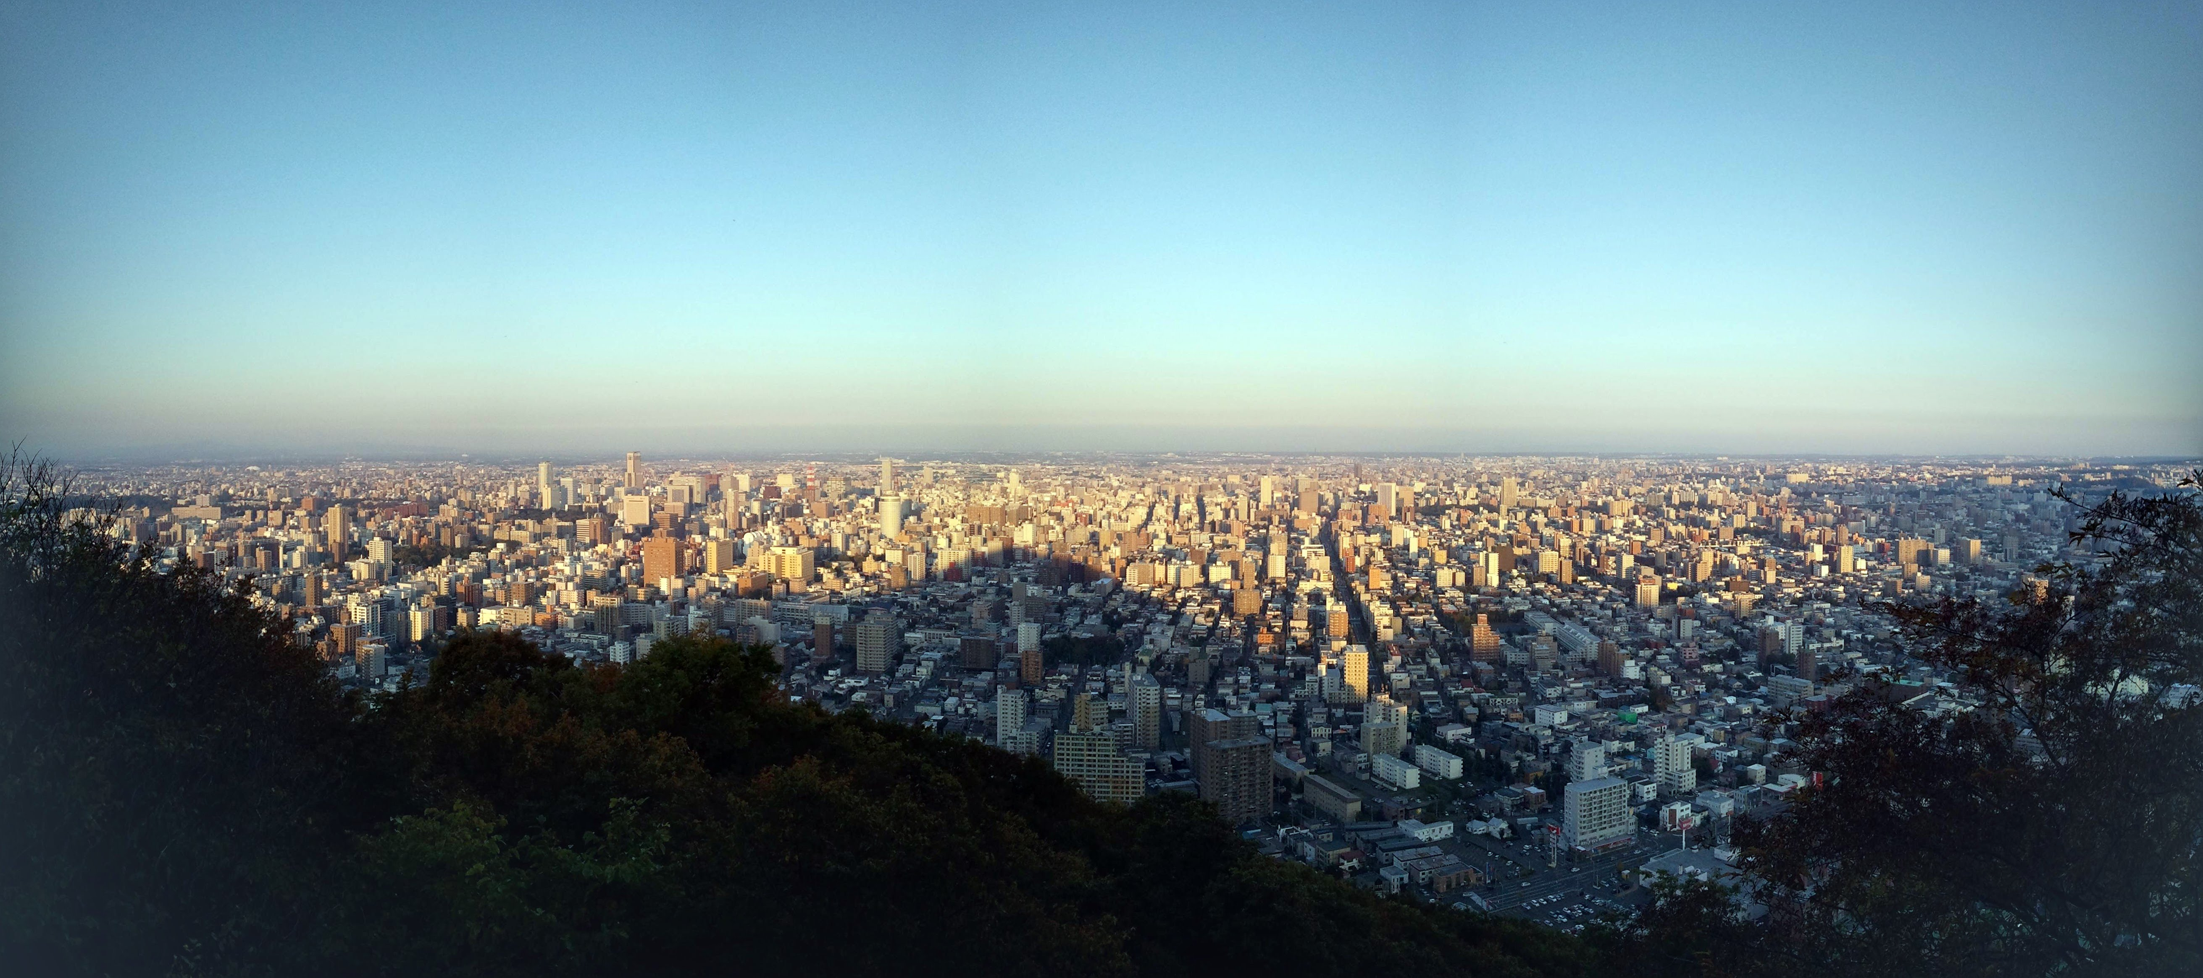
Selling Snowboards in Sapporo, Japan
Mark Streer
METIS (DS/ML)
2021-10-15

Slide 2

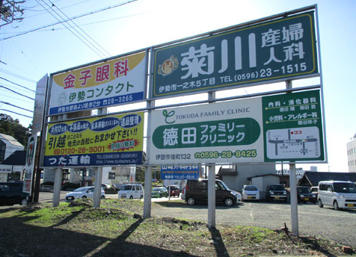
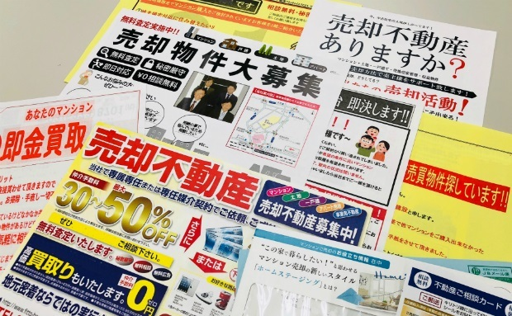
Physical marketing is omnipresent in Japan
Tissue Packs
Flyers
Billboards ・ Posters

Slide 3
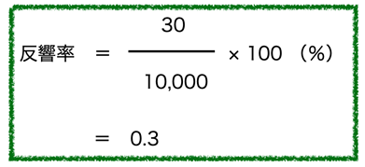
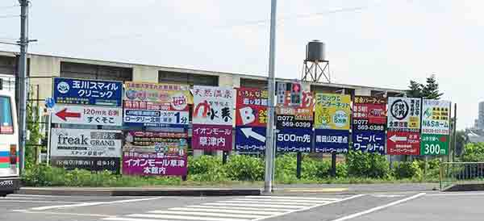
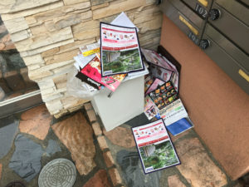
Physical marketing is omnipresent in Japan, but inefficient
Low Response Rates
Stiff Competition
Wasteful

Slide 4

The Client
Snowboard retailer in Sapporo, Hokkaido
Wants to increase revenue
Limited marketing budget
Impact Hypothesis
Focusing flyer distribution within neighborhoods where higher percentages of {target audience} live will result in yen earned per yen spent on ads.

Slide 5
Let Data Science Help!
Collect customer demographic data
Currently registered rewards members
Survey people who give contact info (questionnaires)
Determine {target audience} for ad campaign using data science
What kinds of customers make frequent and/or expensive purchases? (regression)
Do my customers consist of unique groups with predictable shopping behaviors? (clustering)
Young adults
aged 20-29
Parents with children aged < 7
IT labor force
(情報通信業)

Slide 6
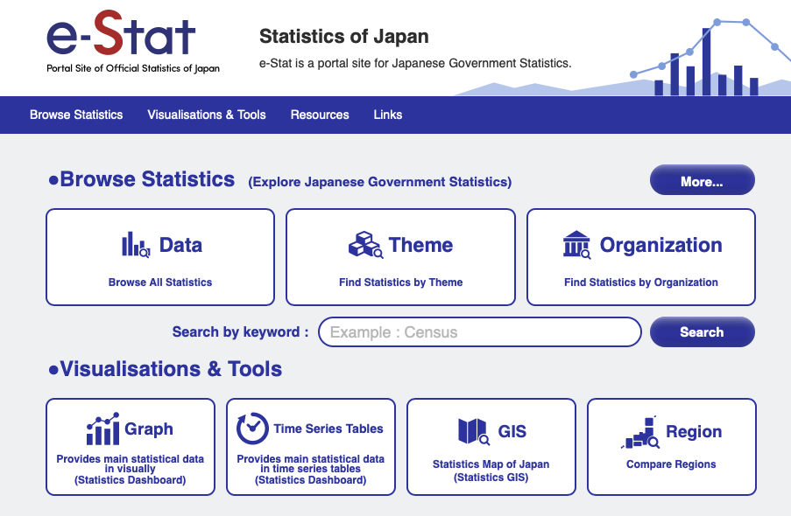
Let Data Science Help!
Identify districts with greatest membership in target audience
Data source: Census of Japan (国勢調査)
Portal Site of Official Statistics of Japan (National Statistics Center, Statistics Bureau, Ministry of Internal Affairs: eSTAT.go.jp)
Statistics available:
Population (residents, households)
Age (5-year bins)
Household type
Occupation/industry (agriculture, management, clerical, etc.)
Family income, education, migration…

Slide 7
Let Data Science Help!
Distribute flyers to mailboxes in target neighborhoods
”5% off your purchase if you mention the flyer”
Encourage visitors to become members for better profiling
Determine success in terms of ROAS (return on ad spending) per
Fiscal quarter (ex. Q4 2021 v. Q4 2019)
Season (ex. Nov-Apr 2021v. Nov-Apr 2019)
Iterate

Slide 8
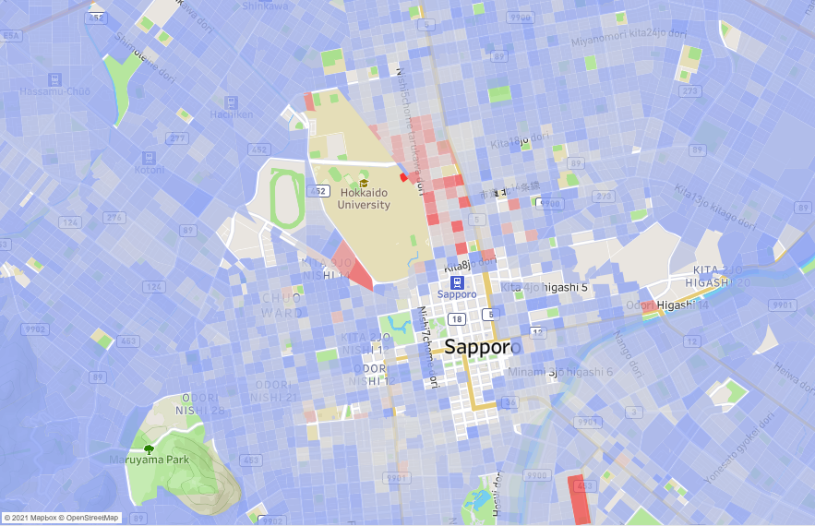
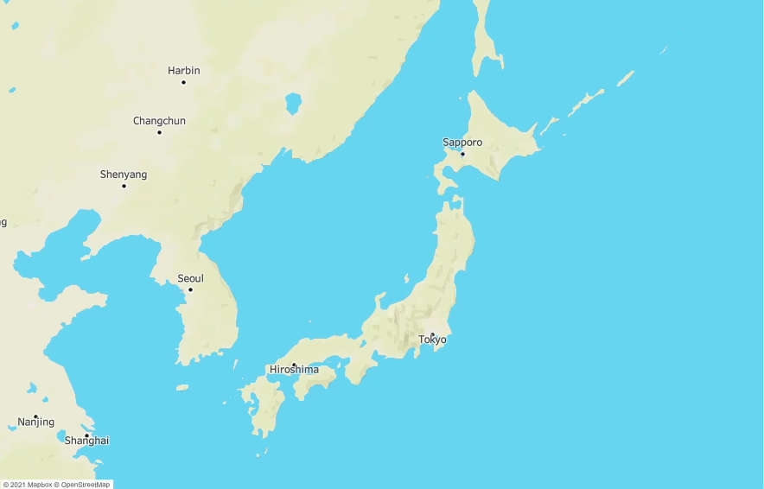
Ex. 1 % Residents aged 20-29
Red threshold: 33%

Slide 9
Ex. 1 % Residents aged 20-29
# flyers needed to cover top 20 districts: ~3,200
Red threshold: 33%

Slide 10
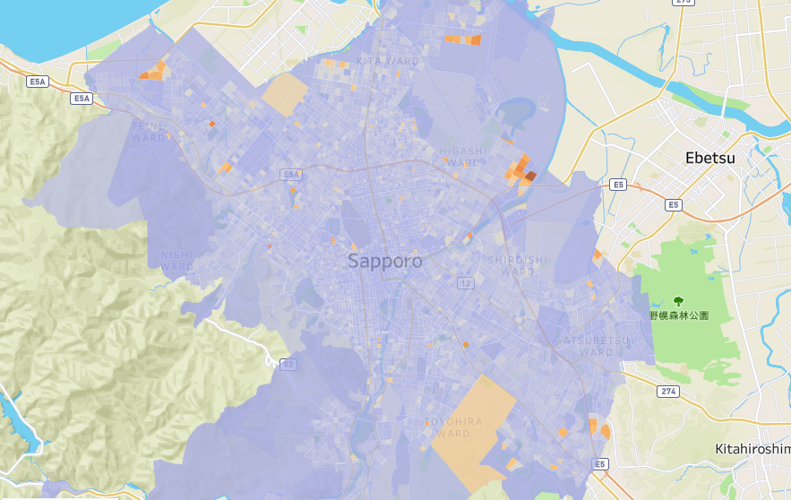
Ex. 2 % Households with children aged 0-6
# flyers needed to cover top 20 districts: ~2,000
Red threshold: 25%

Slide 11
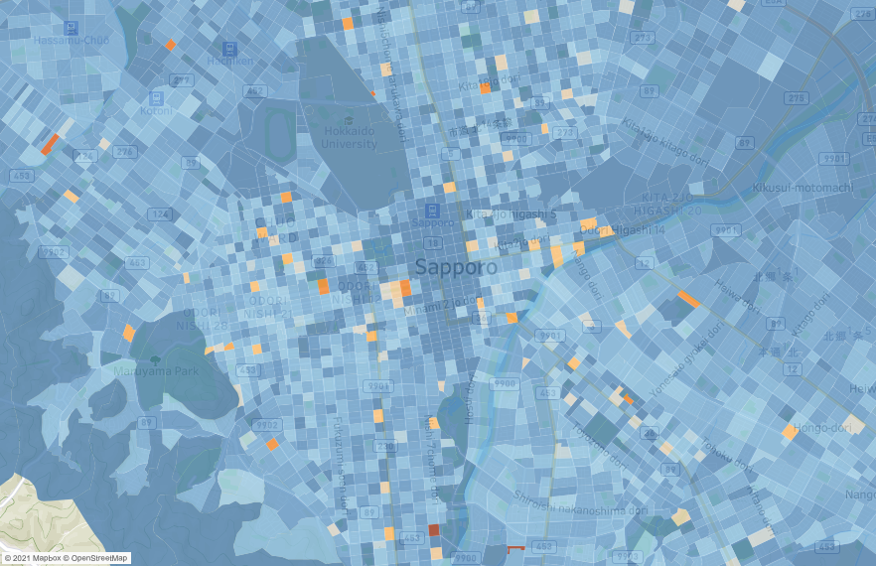
Ex. 3 % Workers in IT sector
# flyers needed to cover top 20 districts: ~1,000
Red threshold: 15%

Slide 12
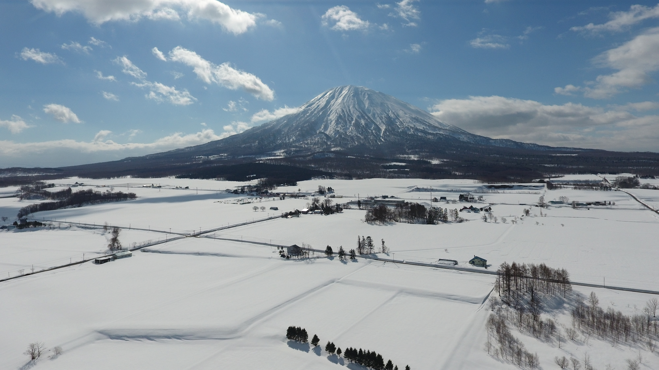
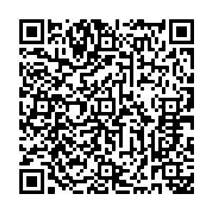
Food for Thought
Explore Maps on Tableau
#visithokkaido

Slide 13
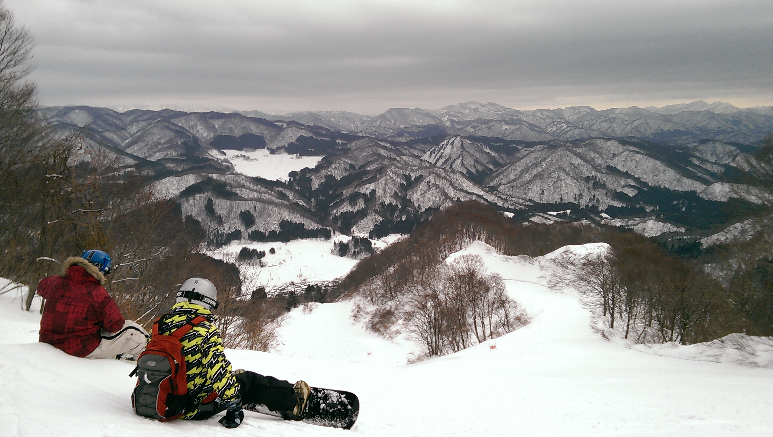
Food for Thought
Generalizable approach to physical marketing

Slide 14
Appendix

Slide 15
Geographic Segmentation
Profiling groups of people living* in similar regions to effectively increase revenue or service usage by customizing them to improve product-market fit and customer awareness
Users | Objectives | Useful data (open-source)
Private sector | Establish local presence Predict cost-benefit and revenue Avoid market oversaturation | Demographic data (population, household size, income, age distribution, etc.) Location data for competing or complementary businesses
Public sector | Determine unmet needs Define scope for NPO bids | Location data for public facilities (parks, schools, childcare centers, etc.)
*working, shopping, browsing, etc.
Think Global ・ Act Local

Slide 16
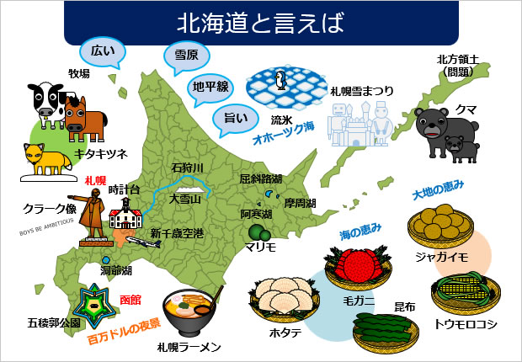

Geographic Segmentation
Think Global ・ Act Local
Source: Digipot.net (www.digipot.net/?p=63032)

Slide 17
Solution paths (traditional)
Distribute flyers near store, in mailboxes or by hand
Audience already in vicinity of store, but…
Physical proximity != buying likelihood for expensive goods
Distant buyers overlooked
Advertise online using Facebook or Google Adsense
Expansive reach and affordable price, but…
Black box difficult to trust/interrogate
Targeting specific audiences = ¥ ¥ ¥

